Slide 1
ASEE EDC Diversity Recognition Program
Guidelines, Criteria, and Review Process - Silver Designation
Javier A. Kypuros, Ph.D.
Dean of the College of Engineering, The University of Texas at Tyler
Director, ASEE Engineering Deans Council (EDC) Executive Board
Chair, ASEE EDC Diversity Committee

Slide 2
Things to Know
The ADRP is an EDC initiative that began with the Deans Diversity Pledge in 2017.
The Pledge: Commit to
Develop a plan.
At least one pipeline activity (K-12 or community college).
Partnerships (collective impact).
Diversifying the faculty.
It was developed, organized, and overseen by EDC members (i.e., engineering deans).

Slide 3
General Review Process
How does the review process generally work?
Call to EDC members sent out in the fall for volunteers.
Reviewers are generally other deans or their designee (e.g., DEI-related associate dean).
Assignments are made based on numerous factors (e.g., current designation, prior review experience, conflicts of interest, etc.).
Three or more reviewers are assigned to each application.
Applicants are reviewed based on the criteria described in the guidelines on the ADRP website.
As of this round, a formal rubric was provided based on said criteria.
The evaluation of each applicant is recorded on a “scorecard” worksheet that is provided.
The EDC Diversity Committee Chair and Co-Chairs review the recommendations for consensus and render a final decision.
In the case of polar mixed reviews, the Chair and Co-Chairs may conduct additional reviews to render a final decision.

Slide 4
Evolution of the Process
Over several years, the process has been adjusted based on lessons learned in each cycle in consultation with committee members.
Said adjustments have been minor and do not substantively deviate from the original criteria.
Subcommittees were formed to establish Silver and Bronze Reaffirmation criteria as the program has evolved.
It is a continuous improvement process.
Further work will be needed to address the impact of anti-DEI legislation and to formulate Gold criteria.

Slide 5
Bronze

Slide 6
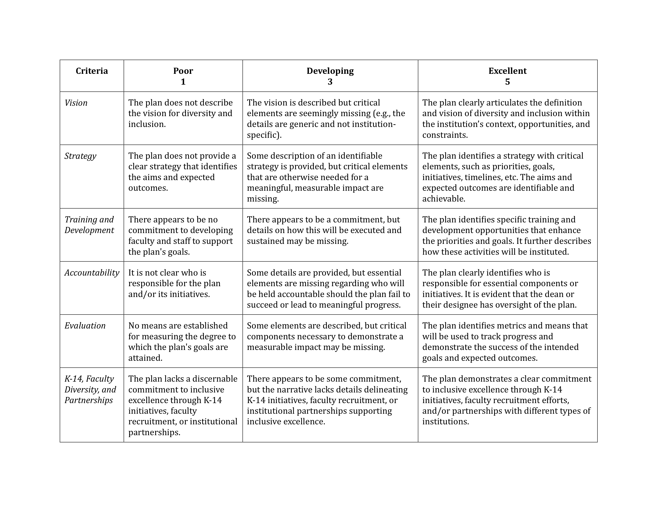
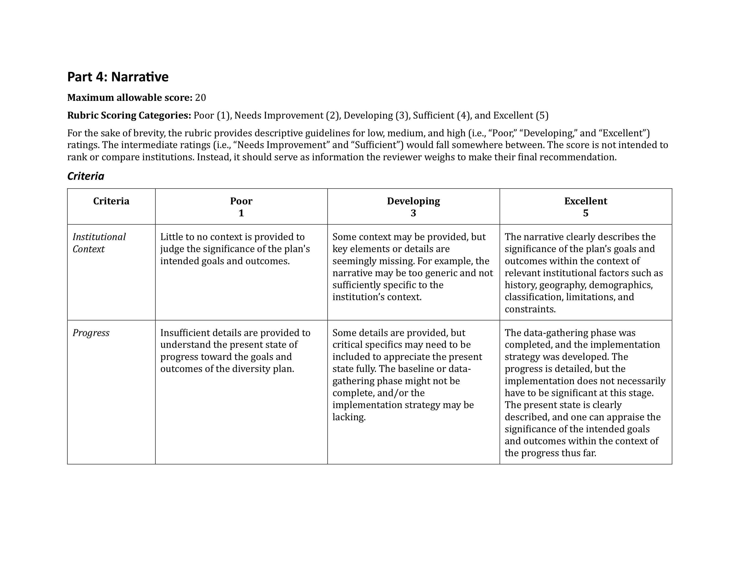
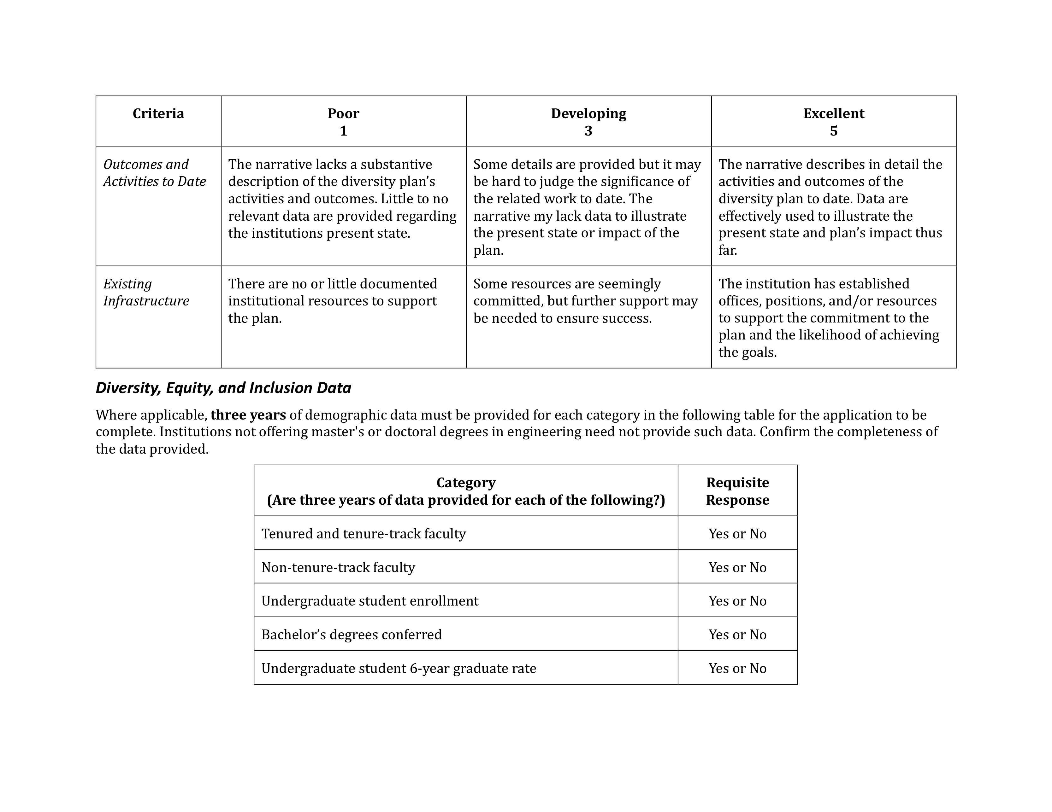
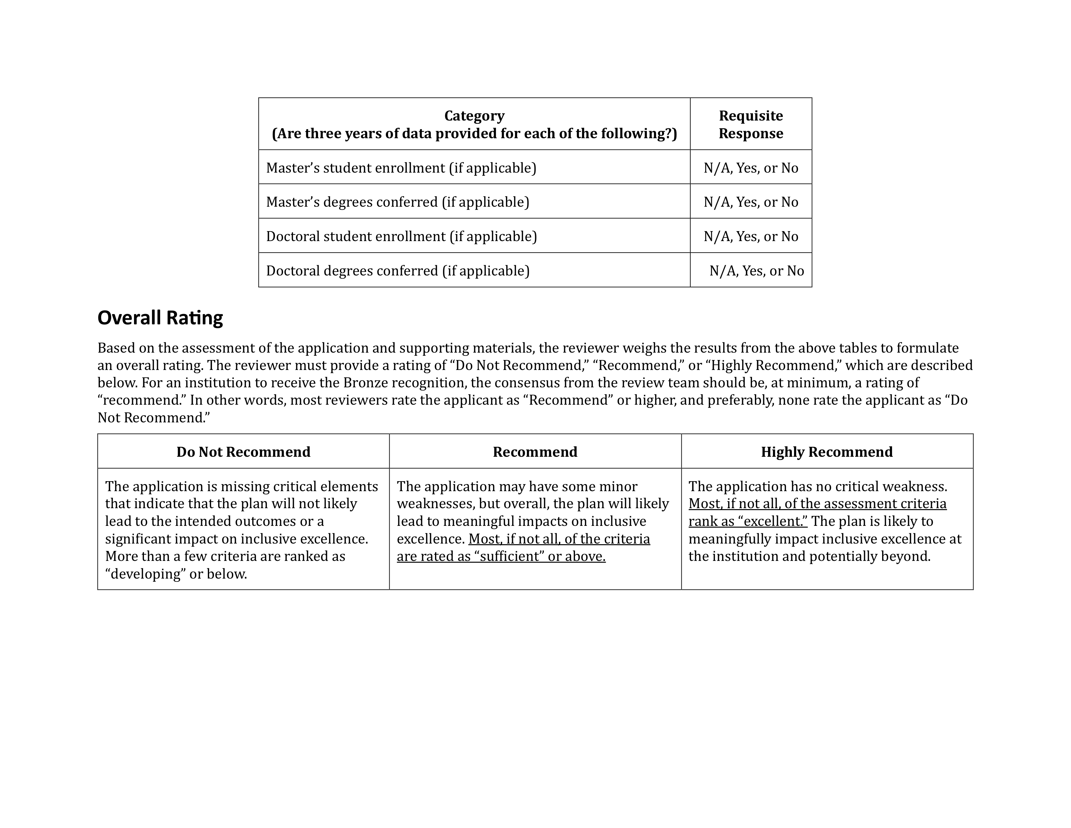

Slide 11
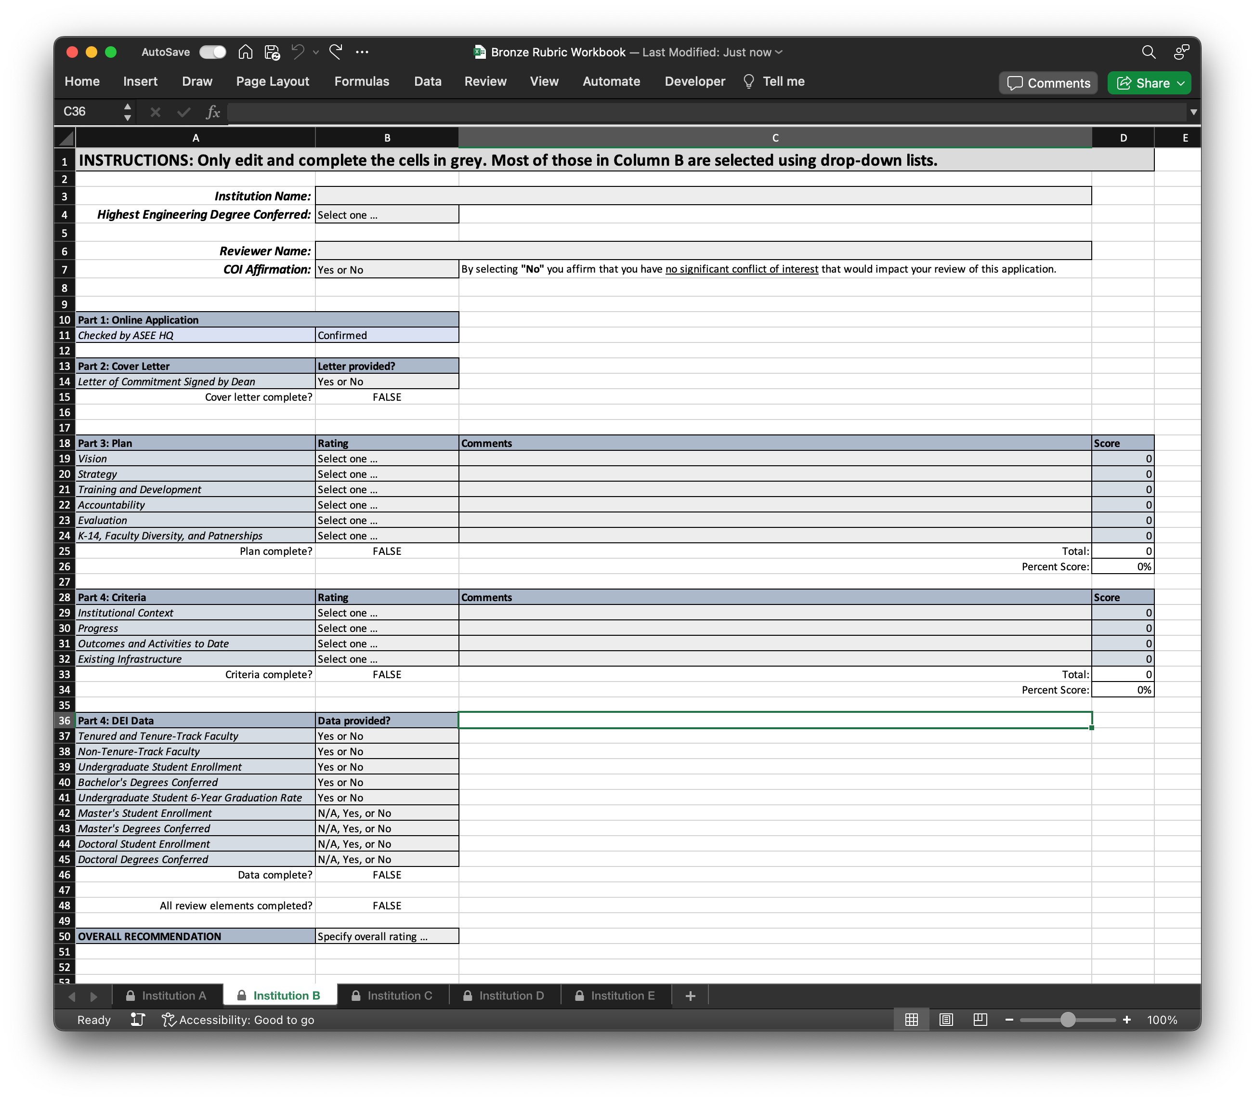

Slide 12
Bronze Reaffirmation

Slide 13
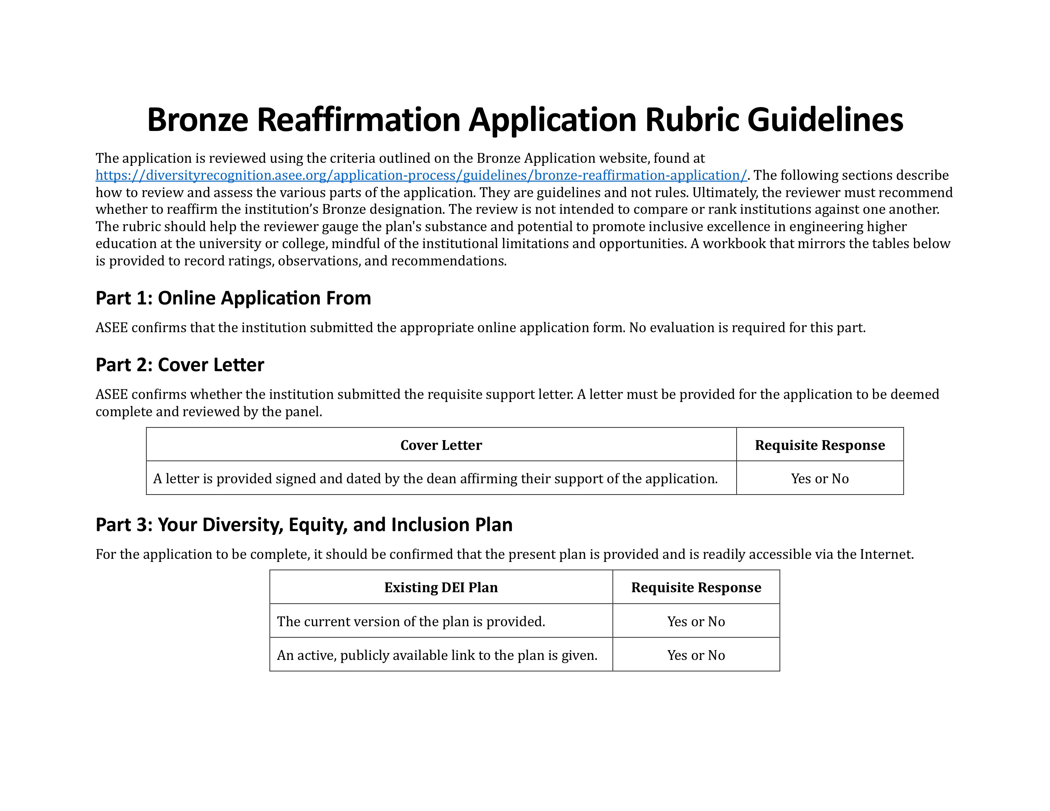
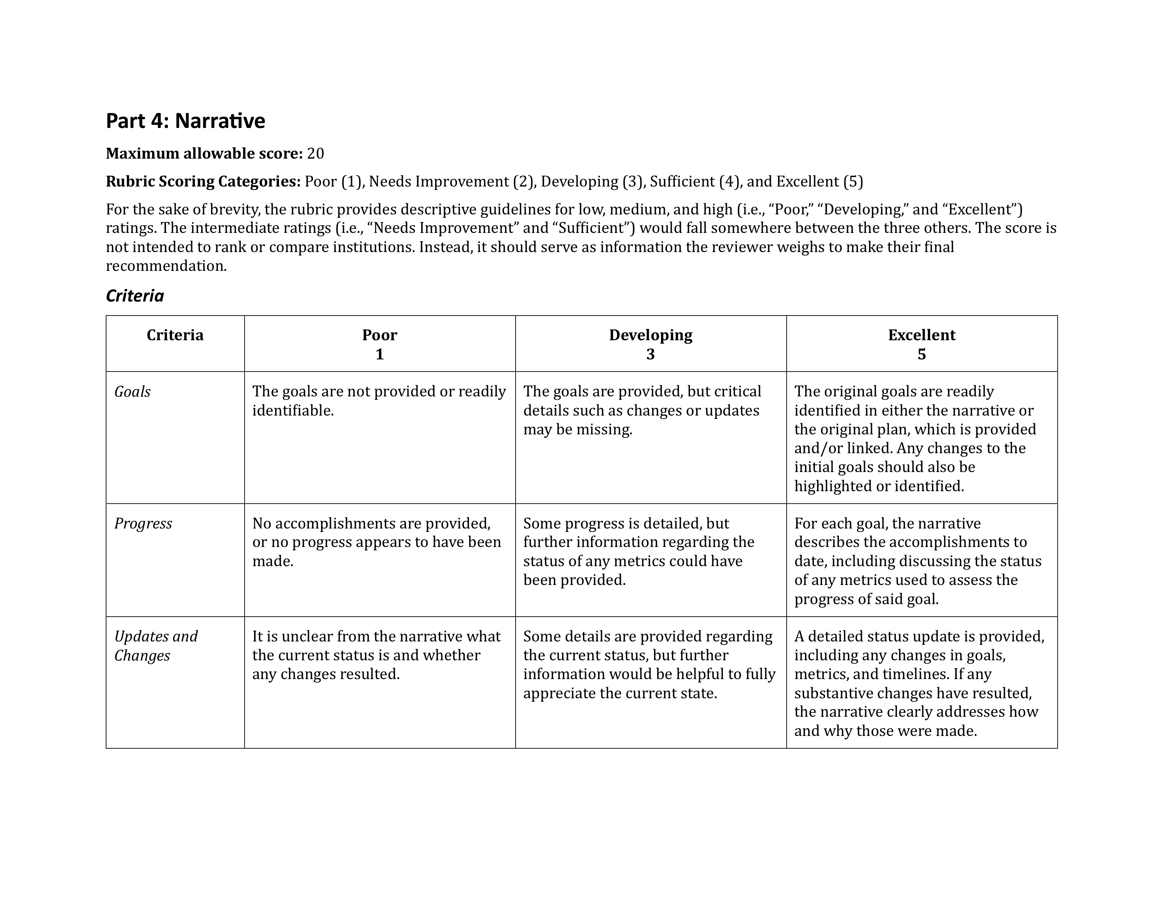
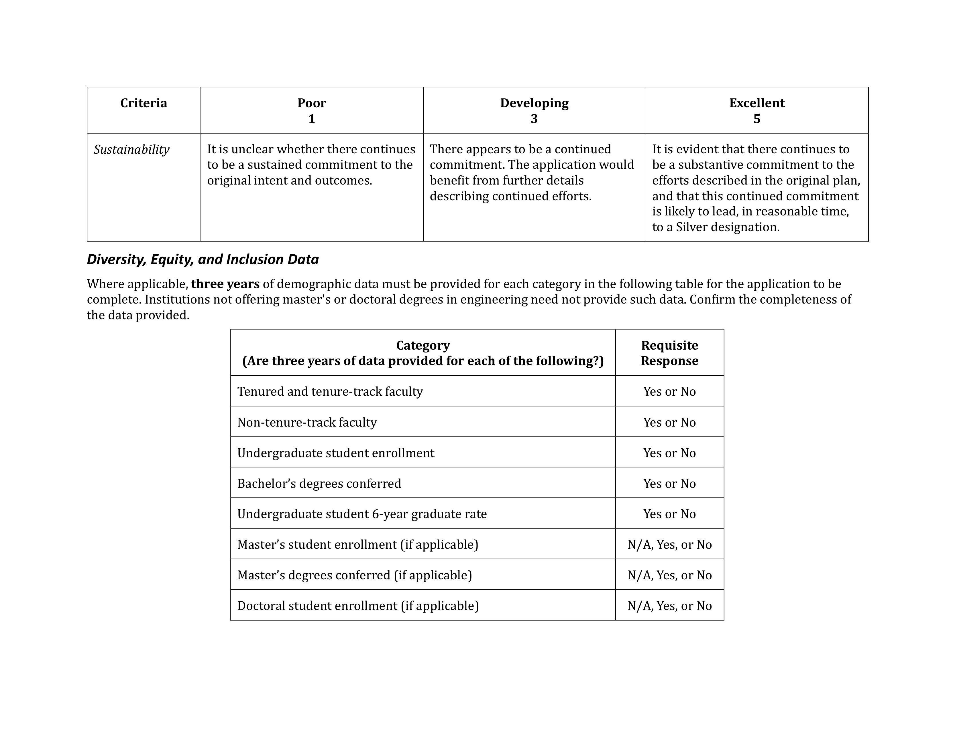
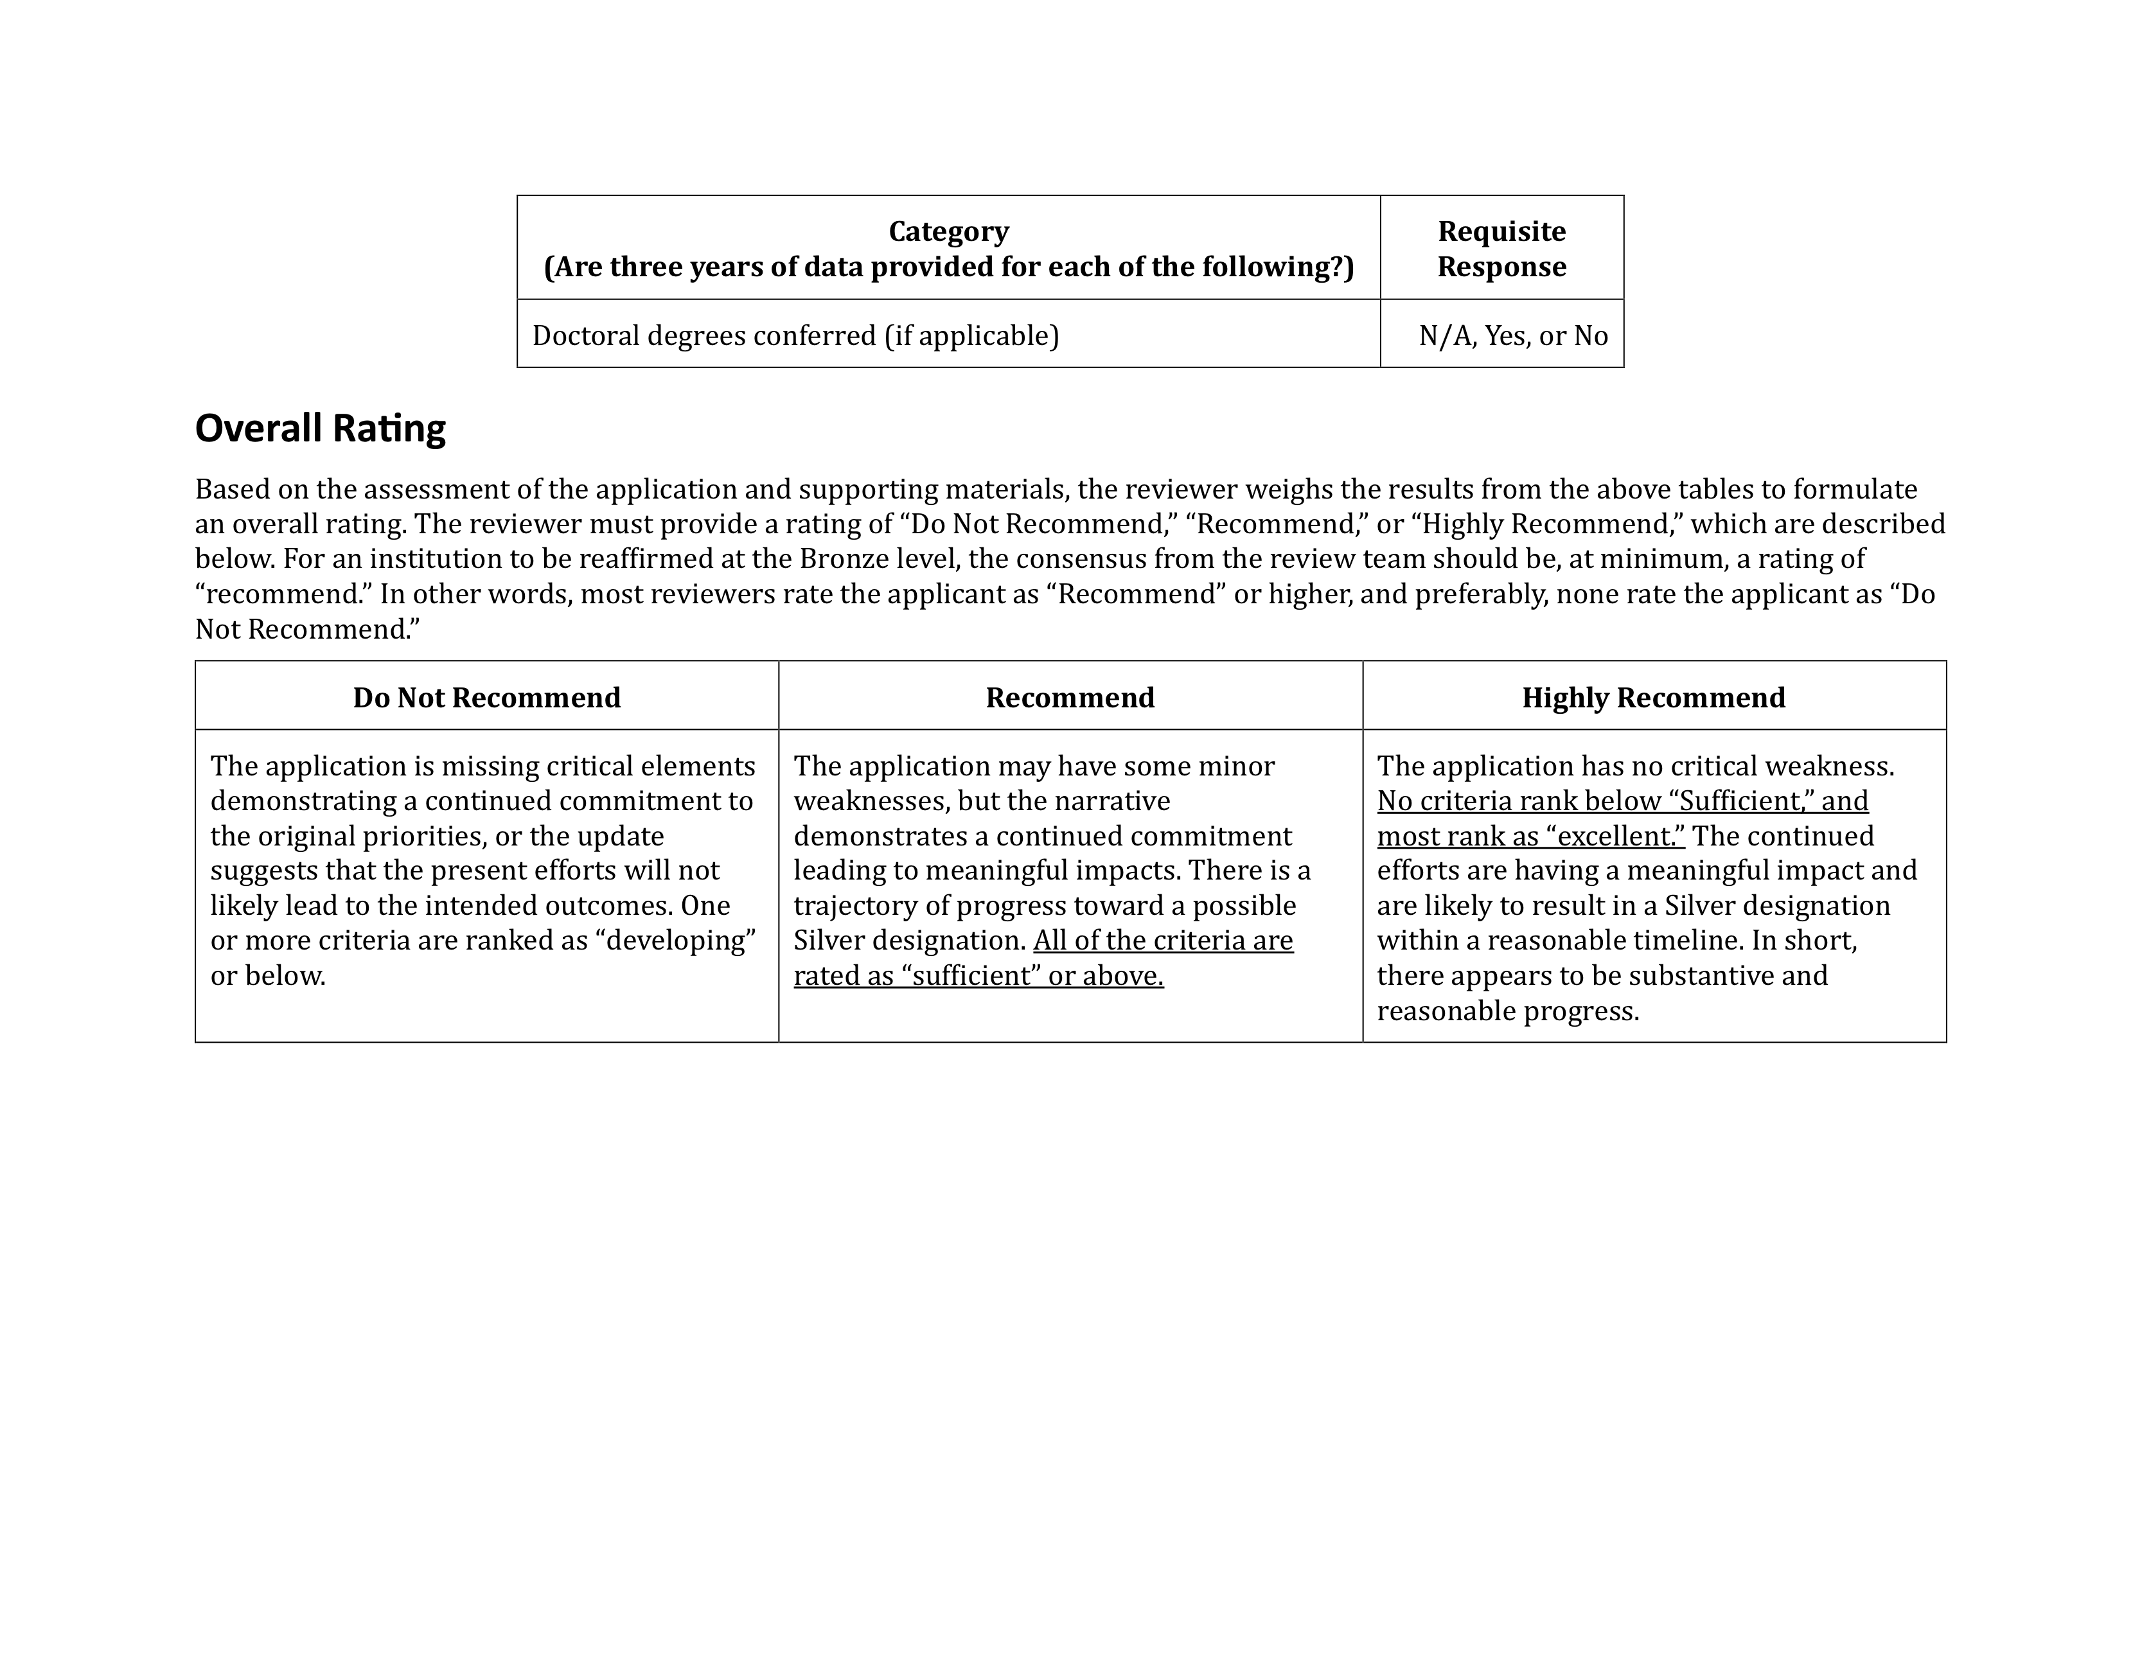

Slide 17
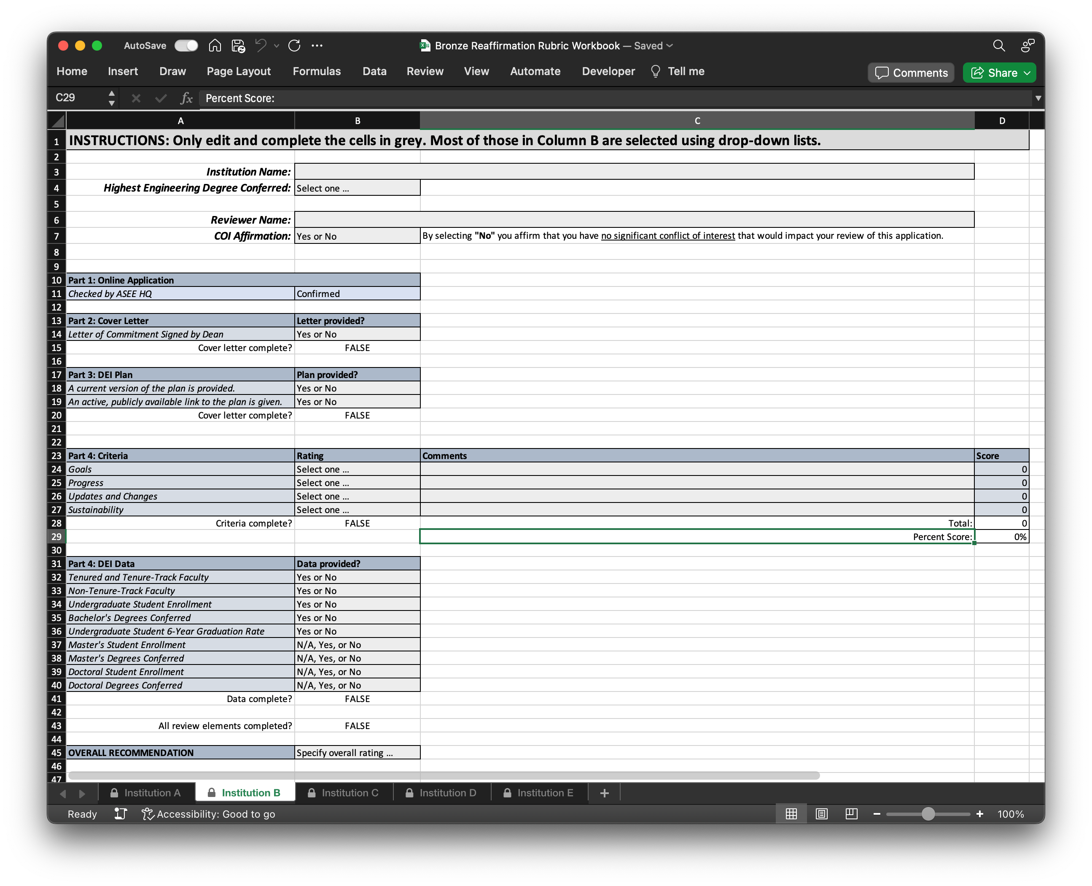

Slide 18
Silver

Slide 19
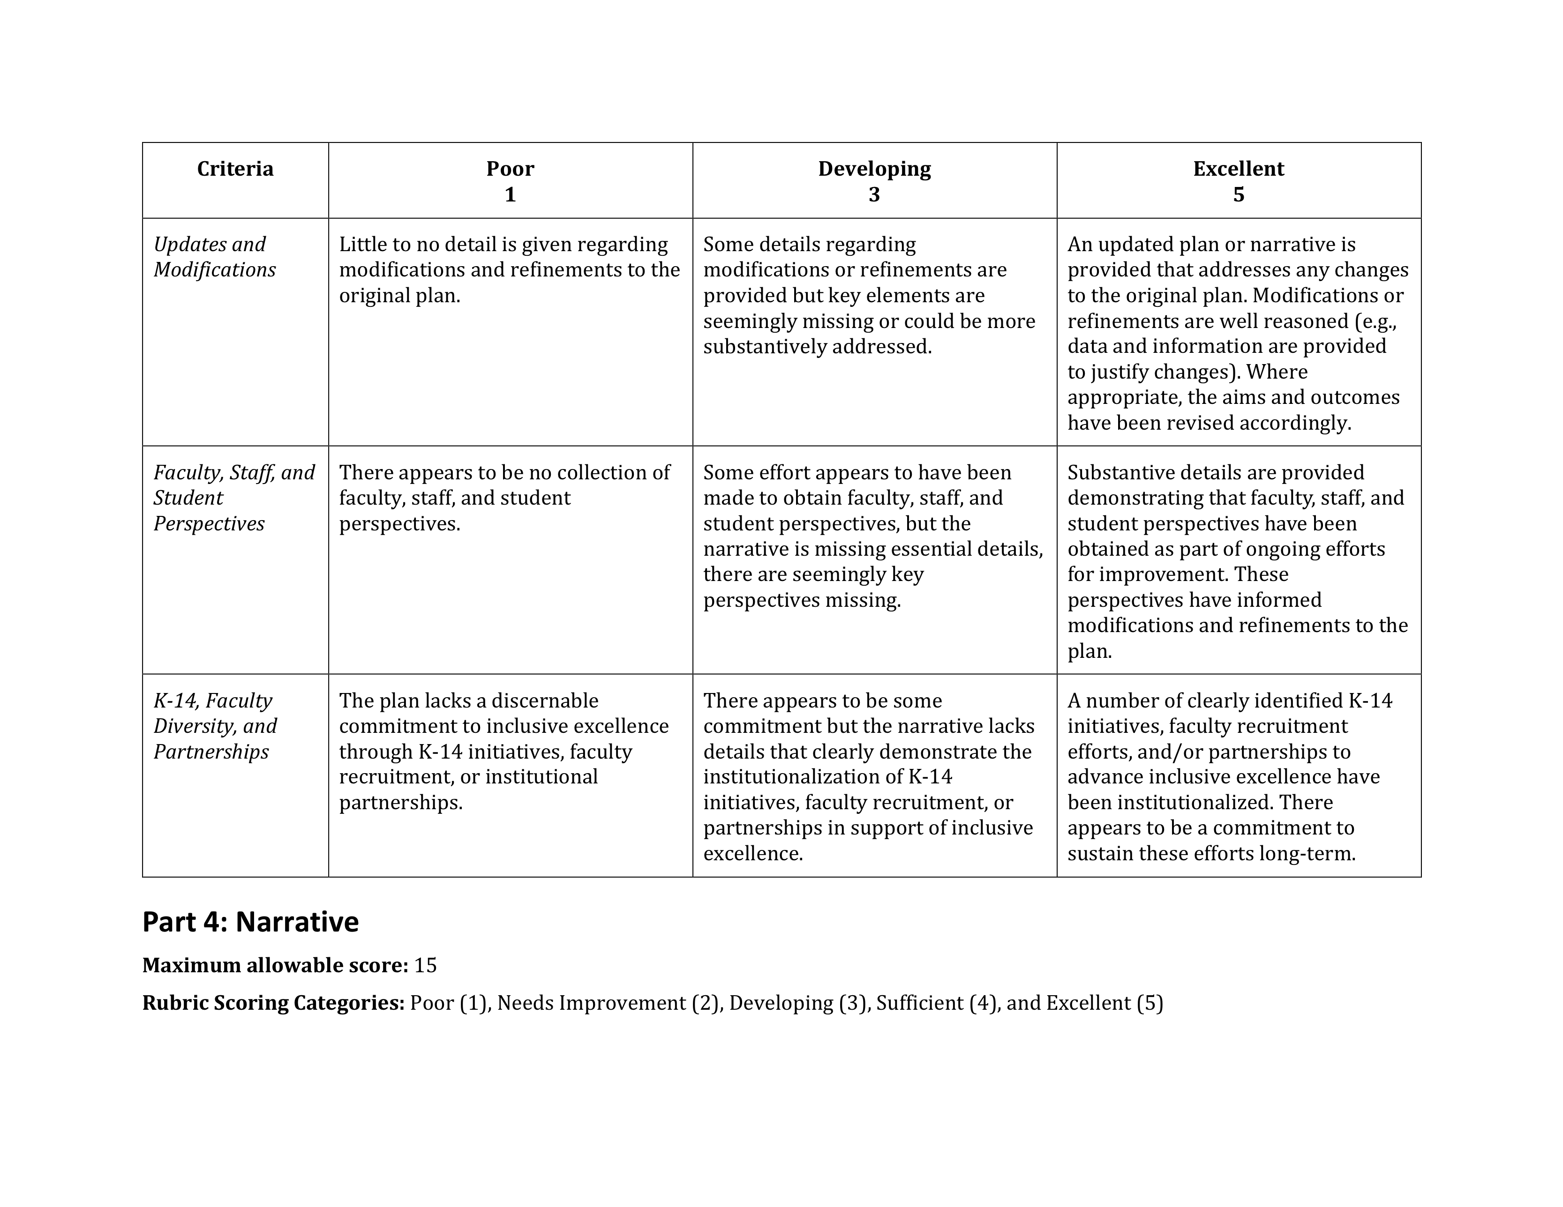
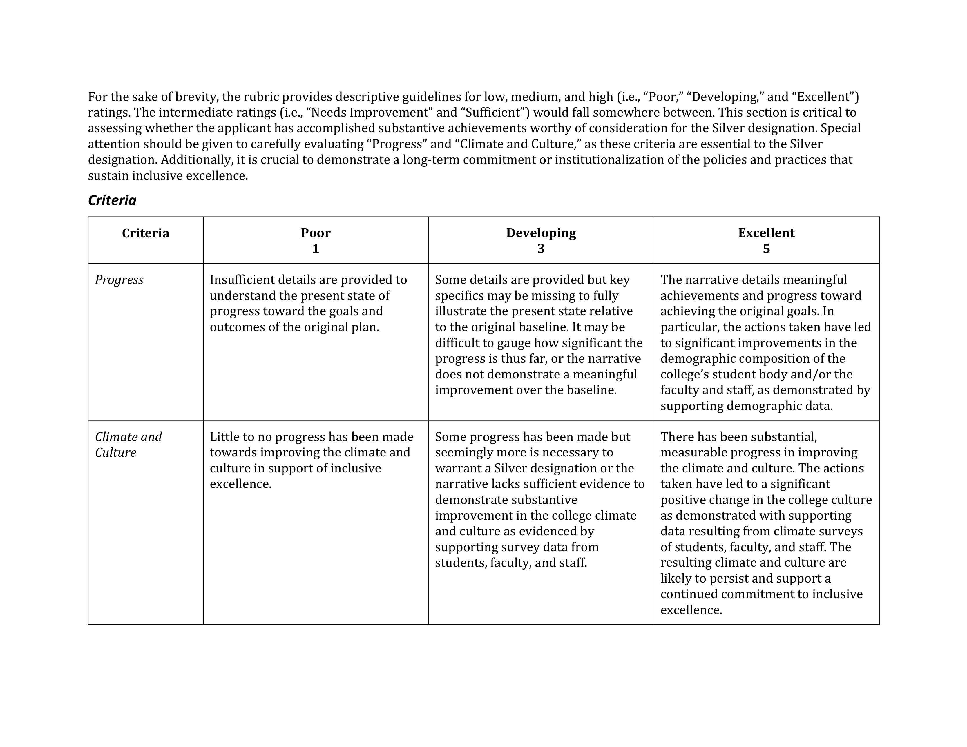
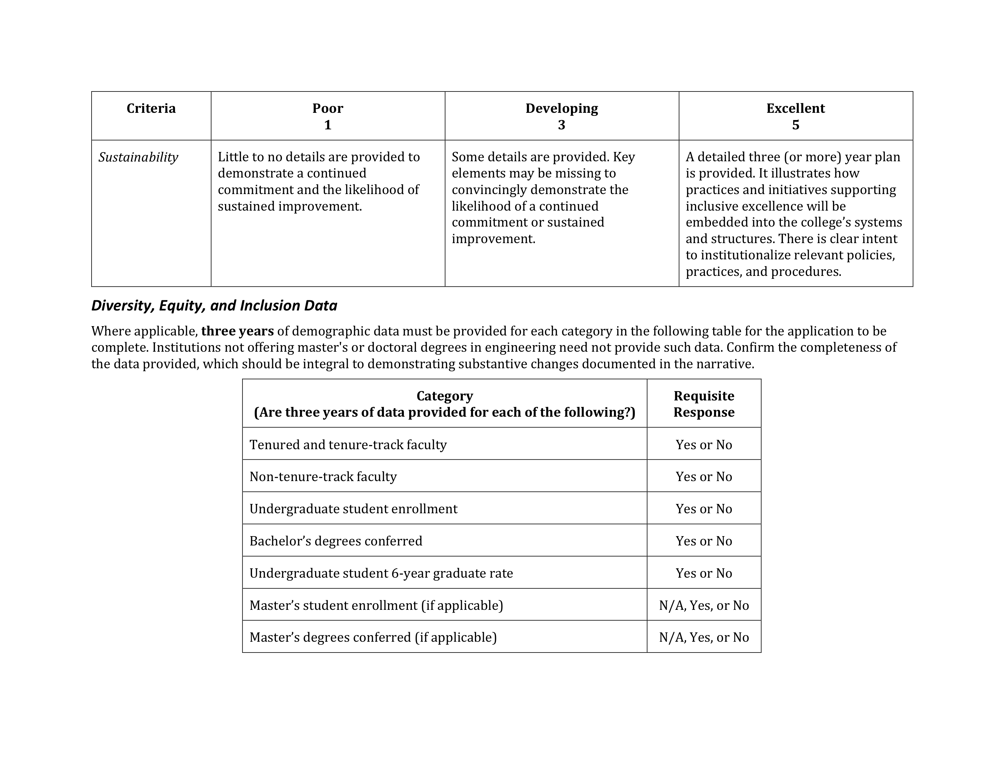
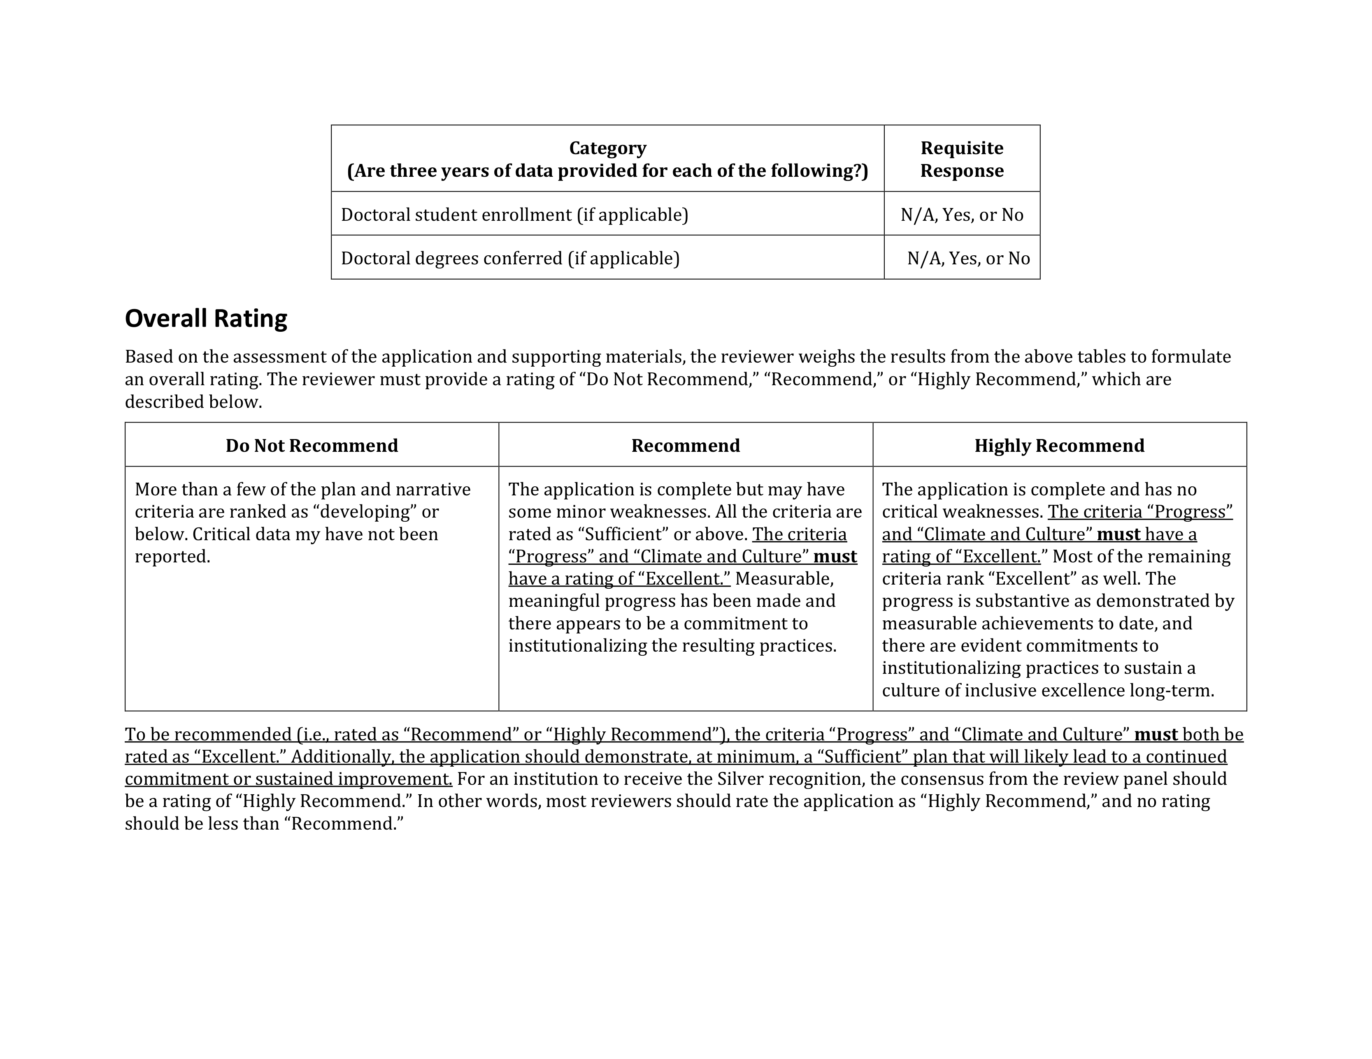

Slide 24
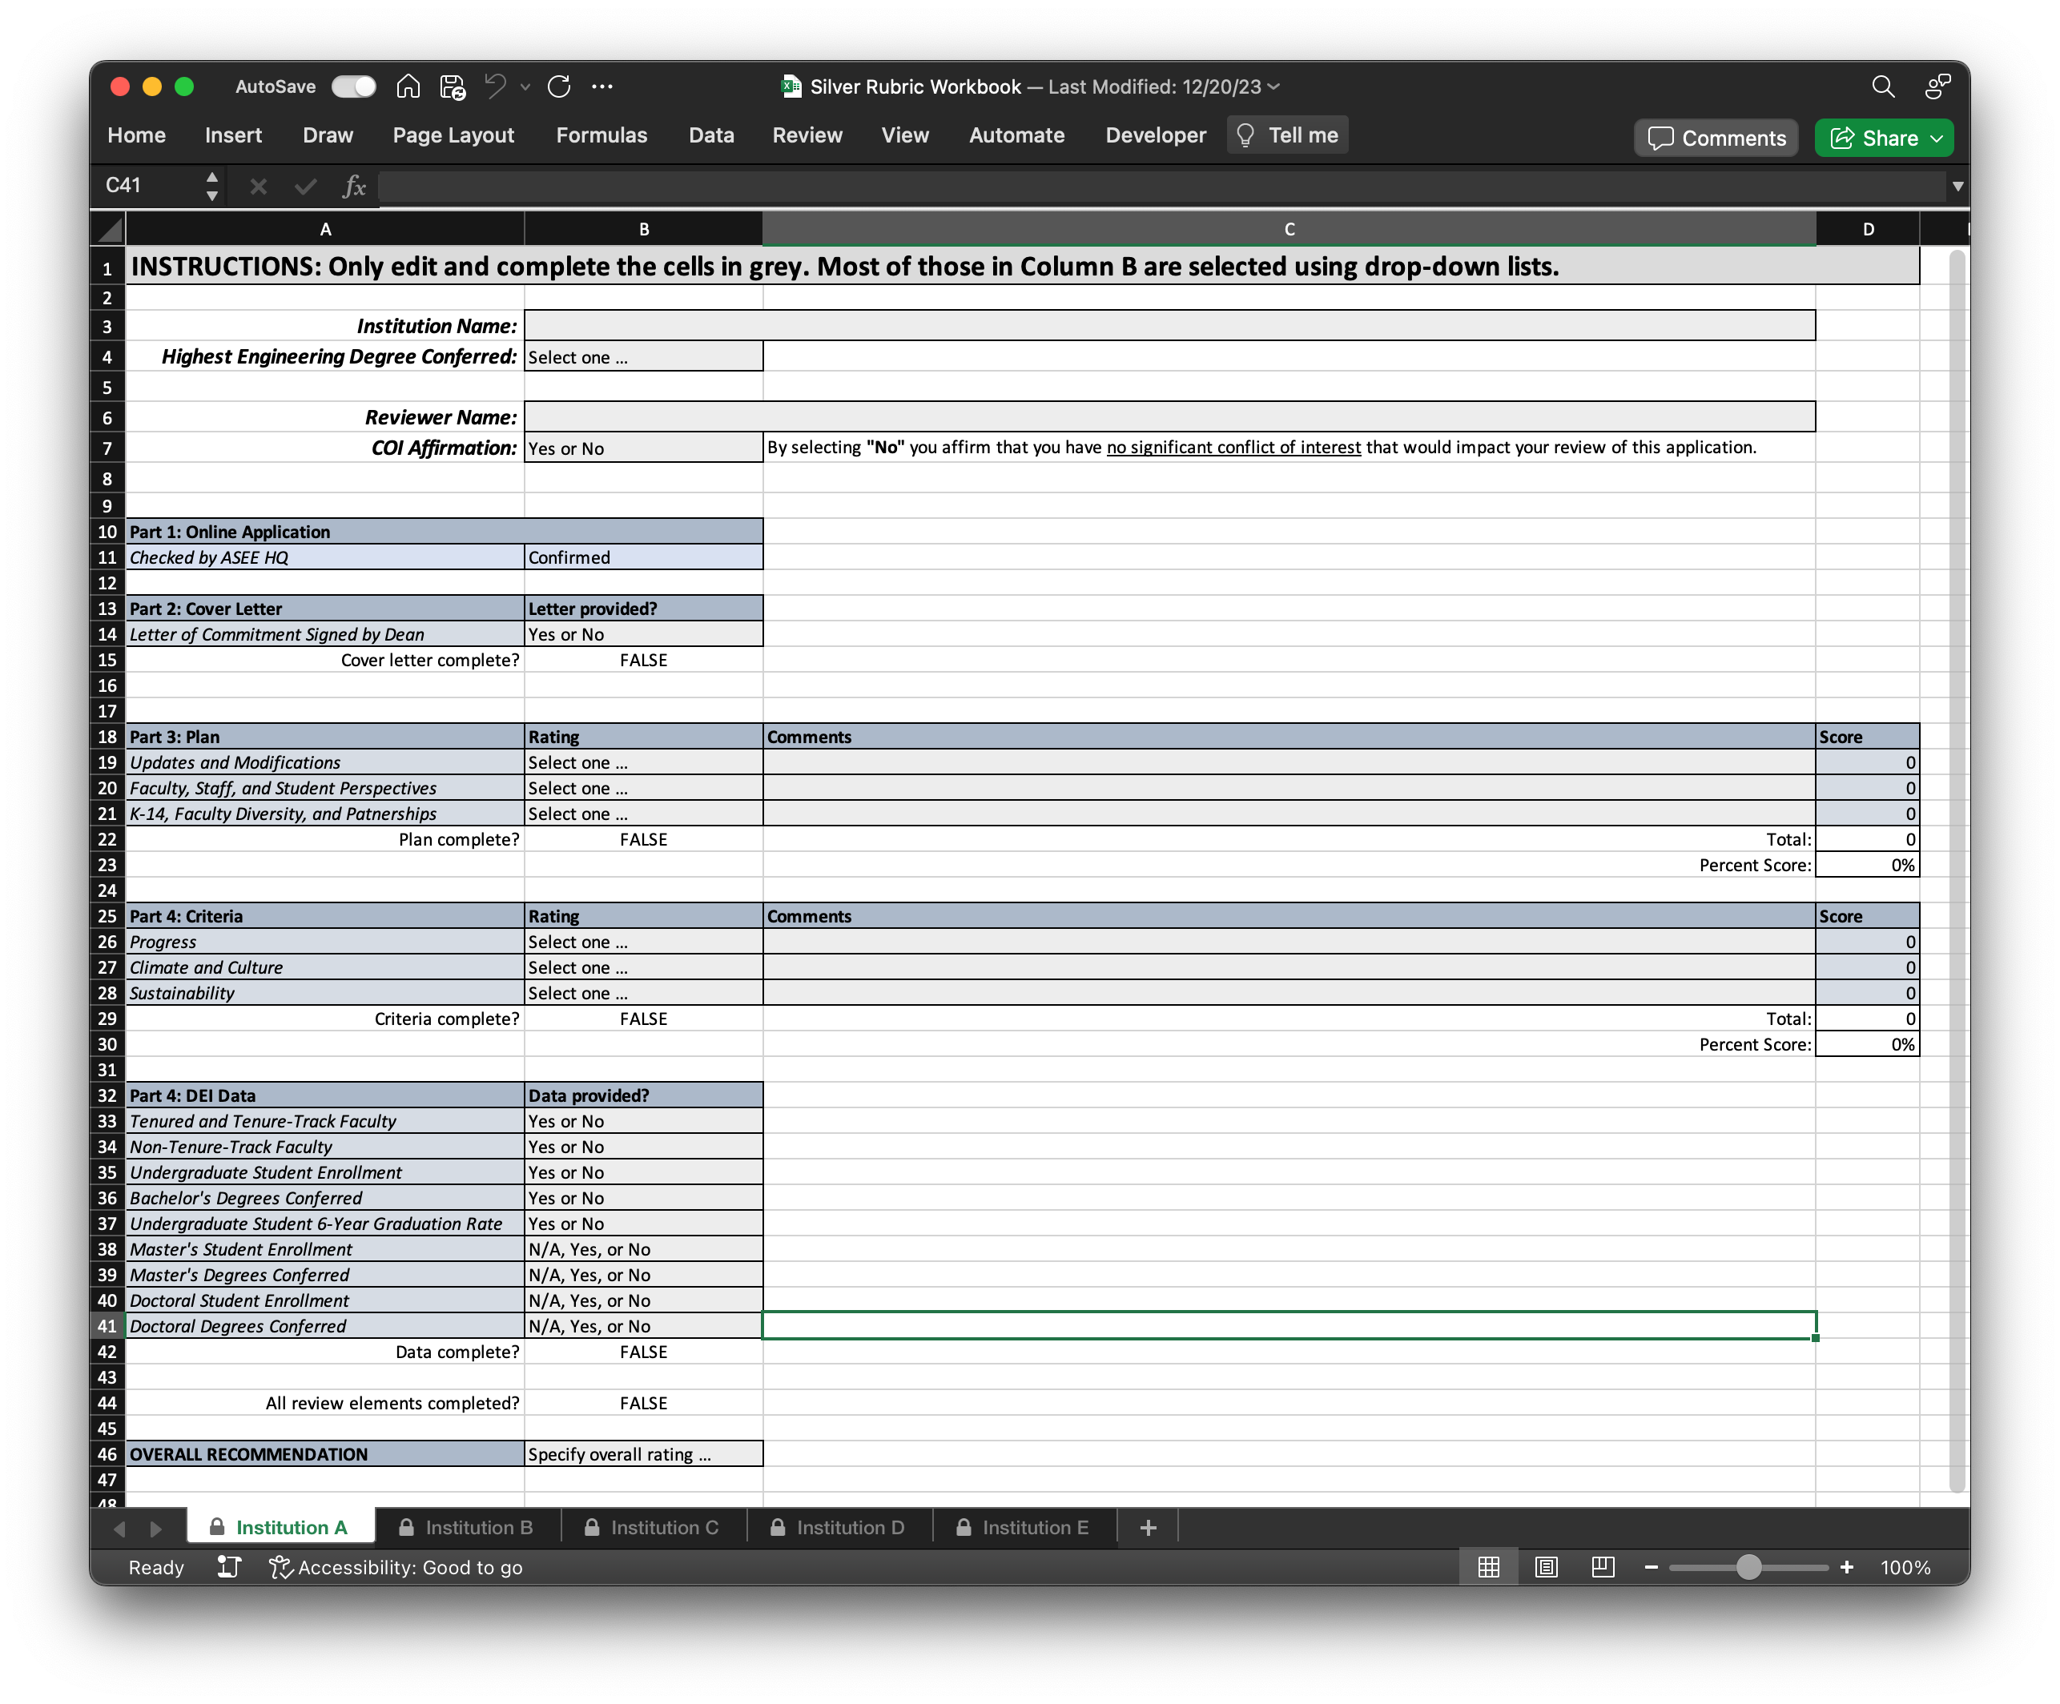

Slide 25
Questions?

